Slide 1
Movie Recommendation
Graph theory
Amstrong roosevelt z
Iup class
5025211191

Slide 2
introduction
In this digital age, people are exposed to an overwhelming number of entertainment options, especially in the world of movies. Online streaming platforms like Netflix, Disney+, and Amazon Prime host thousands of movies across various genres. For users, it can be challenging to discover new movies that align with their unique preferences. This is where recommendation systems come in—they help users find movies they’re likely to enjoy by analyzing patterns in their previous choices and in the preferences of other users.
A simple yet powerful approach to building a movie recommendation system involves graph theory. By modeling the relationships between users and movies as a graph, we can use graph traversal techniques to suggest movies based on users with similar tastes.

Slide 3
Goal of the problem
The goal is to build a basic movie recommendation system that:
Analyzes User Preferences: Determines movies that users like or have rated highly.
Finds Similar Users: Identifies users with similar tastes by looking at movies they have in common.
Recommends New Movies: Suggests new movies that similar users liked but the target user has not seen yet.

Slide 4
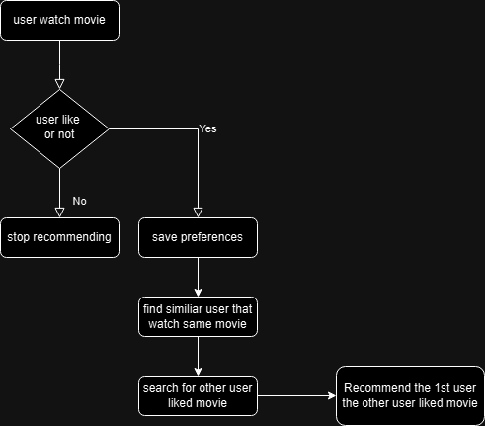
Initial flowchart

Slide 5
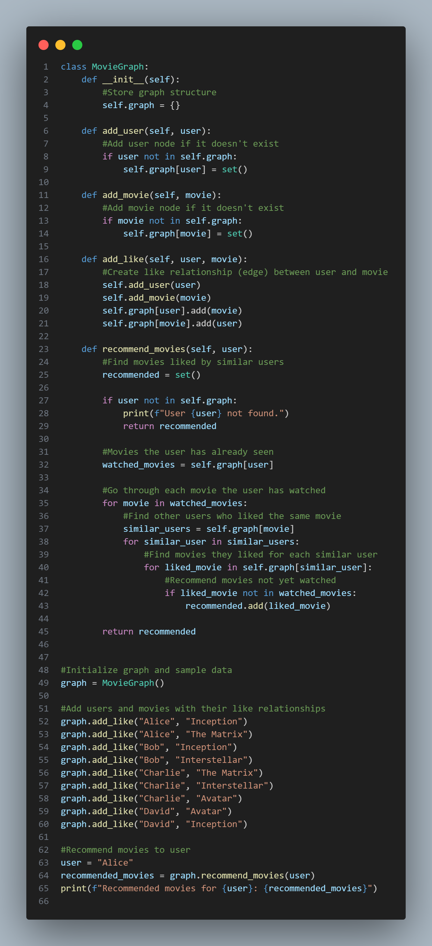

Slide 6
Graph theory Implementation
In this recommendation system, I use graph theory to:
Represent Users and Movies as Nodes: Users and movies are treated as nodes in the graph.
Connect Users to Movies through Likes: When a user likes or rates a movie highly, we create an edge between that user and the movie.
Find Paths to New Movies: By traversing the graph along these edges, we identify paths to movies that similar users have watched and recommend those to the target user.

Slide 7
Why do we use graph theory
Modeling Relationships in a Structured Way:
Graph theory provides a natural and intuitive way to model relationships between users and movies. In this case:
Users and movies are nodes.
A "like" relationship is an edge.
This structure is scalable and extendable, meaning we can easily add new users, movies, and relationships without changing the logic significantly.
Efficient Representation:
A graph-based approach allow to represent relationships once in a reusable structure, such as a list or matrix.
For larger datasets, this is far more efficient than iterating through multiple lists or arrays to check for overlaps repeatedly.

Slide 8
Nodes (vertices) represent entities, like users or movies.
Edges represent relationships, like "Alice likes Inception.“
This structure allows to store all relationships once in a single, reusable representation Instead of writing separate code for each specific comparison or relationship check.
If I want to find movies Alice likes, you would search through the dictionary like :
[ movies = users["Alice"] # Example: ["Inception", "Matrix"] ]
BUT If I WANT to check for overlaps between Alice’s and Bob’s movies, I’d have to loop through their lists or use set intersections:
[ common_movies = set(users["Alice"]) & set(users["Bob"]) ]
Once relationships are added to a graph Alice is connected to movies via edges.
So WE don’t need to repeatedly define how to find connections because the graph structure inherently stores this information.

Slide 9
Comparison
Aspect | With Graph Theory | Without Graph Theory
Structure | Movies and users are represented as nodes in a graph, and a "like" is an edge between them. | Movies and user preferences are stored in dictionaries or lists.
Example | Alice ↔ Inception, Matrix ↔ Bob ↔ Interstellar (Graph) | users = {"Alice": ["Inception", "Matrix"], "Bob": ["Interstellar", "Matrix"]}
Scalability | Easily adds new relationships or nodes by updating the graph. | New relationships require manual updates to dictionaries or lists.

Slide 10
Comparison
Aspect | With Graph Theory | Without Graph Theory
Process | Find all movies connected to similar users but not directly connected to the target user | Check the movies liked by similar users and filter out movies already liked by the target user.
Efficiency | Graph traversal makes filtering straightforward. | Requires manual checks and multiple loops.
Example | Bob likes Interstellar (not seen by Alice), so recommend Interstellar. | Compare Alice's list with Bob's list to find ["Interstellar"].

Slide 11
Pros & cons
Aspect | With Graph Theory | Without Graph Theory
Pros | Efficient for large datasets; scales well; reusable logic. | Simple for small datasets; requires no advanced libraries.
Cons | Requires understanding graph concepts and libraries. | Inefficient for large datasets; complex nested loops.
Scalability | Easily handles hundreds or thousands of users and movies. | Becomes slow as the dataset grows.

Slide 12
Thank you
Very much
///
//
/

